Slide 1
DIGITAL SIGNAL PROCESSING Chapter 3
EEE DSP Teaching Team

Slide 2

Understand the concept of frequency domain analysis.
At the end of this chapter, students should:
Explain what is sampling theorem.
Deduce how under sampling leads to aliasing distortions.
Explain the tradeoffs involved in the selection of sampling frequency.
Explain how an analog voltage may be represented by binary codes.
Notes:
In this Chapter 3, it covers the following :
the sampling theorem.
how under sampling results in aliasing distortions.
the sampling process in frequency domain.
the tradeoffs involved in the selection of sampling frequency
how an analog voltage may be represented by binary codes by quantization.
In this chapter, there are two key concepts
Sampling and quantization
For sampling, it is related to discrete time which is the x-axis of the time domain signals
For quantization, it is related to discrete amplitude which is the y-axis of the time domain signals

Slide 3

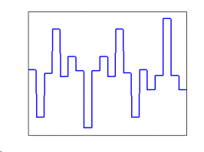
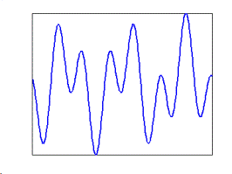
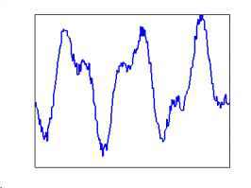
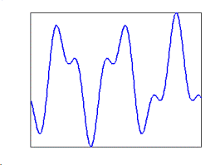
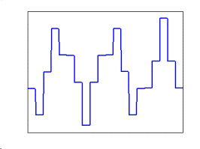
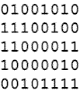
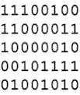
Block diagram of a digital signal processing system
Analog In
Analog Out
Anti-
aliasing
filter
Sampler
Quantizer
DSP
Dequantizer
Reconstruction
filter
CONT-TIME
CONT-AMP
CONT-TIME
CONT-AMP
DISC-TIME
CONT-AMP
DISC-TIME
DISC-AMP
DISC-TIME
DISC-AMP
CONT-TIME
DISC-AMP
CONT-TIME
CONT-AMP
Notes:
In the previous chapter, we have cover this basic block diagram of a digital processing system.
Here the sampler perform the job of sampling to convert the constant time constant amplitude signal into discrete time constant amplitude signal.
Hence the sampler performs the sampling. The sample signal is will only have amplitude values at discrete time.
You can take the output of the sampled signal as the multiplication of the impulse trains with the input signal.

Slide 4
Converting Analog Signals into Digital
Process involves:
Sampling: Conversion of continuous-time signal to discrete-time signal.
Quantization: Conversion of continuous-amplitude signal to discrete-amplitude signal.
After these conversions, the resultant signal must represent the original signal with minimal distortion.
Notes:
These are the two important processes in the whole of digital signal processing
Notice the output signal is a discrete time signal after sampling
and the output signal is a discrete amplitude time signal after quantization
Normally in digital systems, digital data are processed at regular clock interval which is periodically
For example, in one second, you can take 10 samples at 0.1 second interval. If you take more samples such as one hundred, then the processing time as well as the storage requirement will increase.

Slide 5
Sampling
Notes:
Sampling is like taking a snap shot of the signal amplitude at different time intervals, 0, T, 2T, 3T at an interval of T duration.

Slide 6
Sampling
Impulse train, p(t)
switch
Notes:
Here the switch is closed at regular time interval, T and we denote the amplitude as xs(0), xs(T), xs(2T) these are numbers

Slide 7
Sampling
Consider a 1 kHz sinewave sampled at 8000 samples per second. There are 8 samples per cycle, n_{s} = fs/f_{in} where fs is the sampling frequency, 8 kHz and f_{in} is the input frequency, 1 kHz
Notes:
Consider the above 1 kilo hertz sinewave signal, we take 8000 samples in one second. The sampling time is 1/800 that is 0.125 milli second.
If you multiply 0.125 milli second with 8000, you will get one second.

Slide 8
Sampling
Consider the same sine wave sampled at fs,1600 samples per second. Sampling interval, Ts = 1/fs
Ts =1/1600 = 0.626 milliseconds
Notes:
As you can see that if the sampling frequency is reduced from 8000 samples per second to 1600 samples per second, the number of samples per second is reduced. And the samples if you join the dots, the shape will not seem to resemble the original signals.

Slide 9
Sampling
By observing just the samples, can you tell if this is a sine wave?
0
0.25
0.5
0.75
1
1.25
1.5
1.75
2
time in milliseconds
Notes:
It is not necessary like a sine wave. It could be a triangular wave as well. Hence with the number of samples taken per second is not high enough, it results in such kind of problem.

Slide 10
Sampling
How often should the samples be taken?
Very often | Less often
More samples generated Faithful representation Faster computer needed | Less samples generated ???? Slower computer can be used
Notes:
Hence we can deduce that if more samples generated, there is a higher chance of a faithful representation of the original signals.
However, with more samples, we will also need faster computing speed to process and higher storage if needed

Slide 11
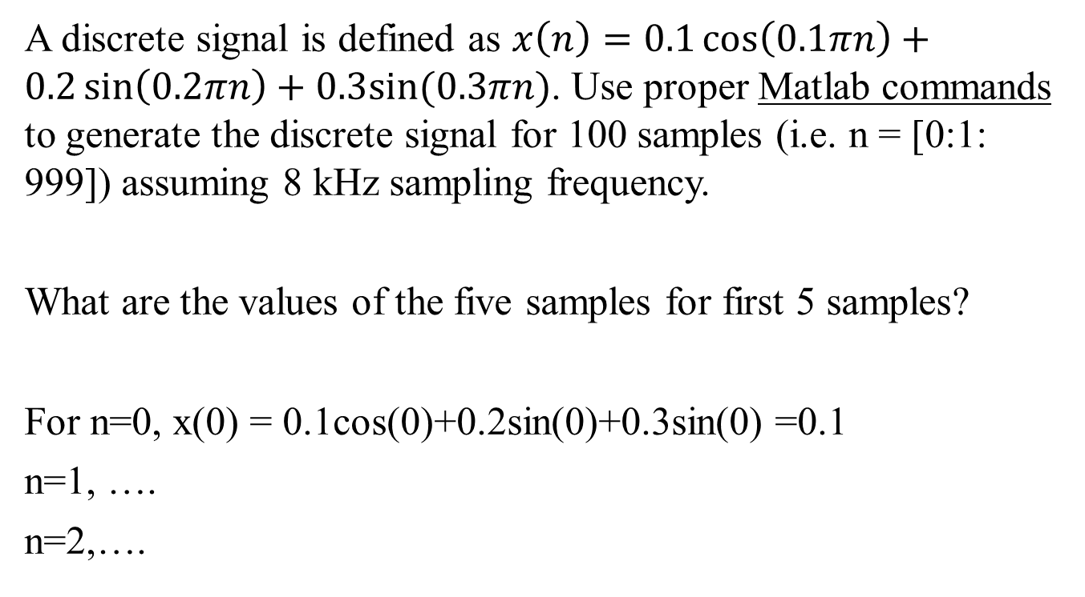
Using Matlab
A discrete signal is defined as $x\left(n\right)=0.1\cos\left(0.1πn\right)+0.2\sin\left(0.2πn\right)+0.3sin⁡(0.3πn)$. Use proper Matlab commands to generate the discrete signal for 100 samples (i.e. n = [0:1: 999]) assuming 8 kHz sampling frequency.
What are the values of the five samples for first 5 samples?
For n=0, x(0) = 0.1cos(0)+0.2sin(0)+0.3sin(0) =0.1
n=1, ….
n=2,….
Notes:
Here the signal has been sampled. If n=0, x0 is the amplitude at time = 0
If n=1, x1 is the amplitude at time, Ts
If n=2, x2 is the amplitude at time, 2 Ts and so for
Sampling frequency is fs

Slide 12
Using Matlab
n=0:999;
fs=8000;
x=0.1*cos(0.1*pi*n)+0.2*sin(0.2*pi*n)+0.3*sin(0.3*pi*n);
x(1:5)
Nth sample | 1 | 2 | 3 | 4 | 5
Sample value | 0.1000 | 0.4554 | 0.5564 | 0.3417 | -0.0279
Notes:
Using the above Matlab commands, you can easier check your manual calculated answers using the Matlab software for the first 5 samples
There will be more practice in the lab sessions

Slide 13
What happens if we don’t sample properly?
If sampling frequency is inadequate this may result in aliasing distortion.
Notes:
Here we see that if the sampling is dropped even closer to the signal frequency, it results in a very low frequency of a few hertz rather than one kilo hertz
The collected samples could not be able to easily deduce the original sine wave. In other words there is not enough information about the original signal.
This is called aliasing. The distortion of the signal where the resulted sampling frequency is different from the original frequency.

Slide 14
Sampling from frequency domain perspective
Consider a 1 kHz sine wave. Using Fourier transform, its spectrum is:
Time Domain
Frequency Domain
0.5
0
1
2
-1
1
t(ms)
f(KHz)
Notes:
Consider a 1 kHz sine wave. Its time and frequency spectrum plots are shown

Slide 15
Sampling in frequency domain
What happens to the spectrum when this sine wave is sampled at 8 kHz?
….
….
Replica at 8kHz
,16kHz, …
Notes:
If the sine wave is sampled at 8 kHz, both the sampled signal in time domain and frequency spectrum plot is shown. It can be seen that when the sine wave is sampled, its spectrum replicates itself at multiples of the sampling frequency. In this example, the spectrum will replicate at 8 kHz, 16 kHz, 24 kHz … and so on. At the same time, the amplitude of the spectrum is scaled by a factor of 1/Ts where Ts is the sampling interval and fs=1/Ts and fs is the sampling frequency 8 kHz.

Slide 16
Sampling in frequency domain
To recover original spectrum, sampled signal is sent through an ideal LPF.
The cut-off frequency of the filter is chosen to be half the sampling frequency.
LPF
Original signal
Notes:
If an ideal low pass filter or reconstruction filter with cut-off frequency at half the sampling frequency of 4 kHz is used to remove the replications, it can be seen that the original sine wave spectrum is recovered.
There is no aliasing distortion. You get back on your original signal.

Slide 17
Sampling
Continuous signal can be recovered from the discrete-time signal through a low pass filter ( reconstruction filter)
The cut-off frequency of the filter is set at half of the sampling frequency (in this example 4 kHz).
Reconstruction filter
fc=4kHz
Notes:
The cut-off frequency is set at 4 kHz, half of the sampling frequency in this example.
The time domain signal can be faithfully reproduced.

Slide 18
Aliasing in frequency domain
Now, consider the case of a 1 kHz sine wave sampled at 1600 Hz.
Spectrum of the original analog signal is given as:
Time Domain
Frequency Domain
0.5
0
1
2
-1
1
t(ms)
f(KHz)
Notes:
Consider another case of using sampling frequency as 1600 hertz
What do you think?
Is there any aliasing distortion?

Slide 19
Aliasing in frequency domain
Spectrum of the sampled signal is:
Time Domain
Frequency Domain
Overlapping
0.5/T
0
1
2
-2.2
-1
1
2.2
t(ms)
-2.6
-0.6
0.6
2.6
f(KHz)
Notes:
Follow the earlier steps, you will notice that the there is an overlapping of sampled signals in the frequency domain.
Notice carefully, there is 600 hertz signals due to the sampling process.

Slide 20
Aliasing in frequency domain
Reconstruction filter response
0.5/T
LPF
-2.6
-2.2
-1
1
2.2
-0.6
0.6
2.6
f(KHz)
A 600 Hz sine wave is obtained when reconstruction filter is used.
When aliasing occurs, the original signal can not be recovered.
Notes:
If the ideal low pass filter or reconstruction filter with cut-off frequency at 800 hertz that is half the sampling frequency of 1600 hertz is used to recover the original signal, a 600 hertz sine wave is obtained at the output of the filter instead of the original 1 kilo hertz sine wave

Slide 21
Aliasing problem
If the samples are sent through a reconstruction filter:
We obtain 600Hz sine wave instead of original 1kHz sine wave!
Reconstruction filter
Notes:
Hence with a much lower sampling frequency of 1600 hertz, we obtain the sampled signal after the reconstruction filter to be 600 hertz instead of 1000 kilo hertz.
Aliasing occurs. We do not get back the original signal.

Slide 22
Minimum sampling frequency
So, what is the minimum sampling frequency without distortion?
Consider the following sampled signal:
0
0.25
0.5
0.75
1
1.25
1.5
1.75
2
time in milliseconds
Notes:
The figure above shows that there must be at least 2 samples per period of the signal that is the sampling frequency must be at least twice the original signal frequency.

Slide 23
Minimum sampling frequency
The least number of samples needed to represent the sine wave is to take one sample from each positive and negative cycle.
Hence, for a sinusoid of frequency f_{m}, the minimum sampling frequency must be f_{s} ≥ 2f_{m}.
In practice, f_{s} = 2f_{m} is not used to avoid all-zero output.
Speech BW = 0 to 7 kHz
Telephone BW = 0 to 4 kHz
Music BW = 0 to 22 kHz
BW - bandwidth
Notes:
This cut off frequency, fc is commonly referred to as the Nyquist frequency, and the frequency, 2 twice fc that must be exceeded by the sampling frequency is called the Nyquist rate†. After bandlimiting, the highest sinusoidal component of the signal will have a frequency of fm (highest frequency components of the original signal)= fc (cut-off frequency of anti-aliasing filter).
Some authors use Nyquist frequency and Nyquist rate interchangeably to mean the minimum sampling frequency. This may cause some confusion among readers. In this book, Nyquist rate indicates minimum sampling frequency.

Slide 24
Sampling in frequency domain
Important points to note :
The spectrum replicates itself at multiples of the sampling frequency.
The magnitude of the spectrum is scaled with a factor of 1/Ts where Ts is the frequency interval and fs = 1/Ts.
Notes:
By sampling in the time domain, we see that in frequency domain, the spectrum replicates itself at multiples of the sampling frequcency at fs, 2fs, 3fs..

Slide 25
Aliasing in frequency domain
Important points to note :
Replication of the original spectrum results in spectra to overlap, if f_{s} is not chosen properly.
This gives rise to aliasing distortion.
Notes:
The selection of the sampling frequency is important. If the sampling frequency does not meet the Nyquist sampling theorem where fs is greater or equal two times the highest frequency component of the signal, aliasing occurs.

Slide 26
Key points
Signature of signal in frequency domain
Fourier Transform
Notes:
Fourier transform is used to convert time domain signal to frequency domain.

Slide 27
Key points :
Time signal
Signature of signal in frequency domain
Notes:
By sampling, we produce duplicates of the original frequency spectrum at multiple sampling frequencies.
fm is the highest or maximum frequency component of the signal

Slide 28
Sampling frequency requirement
Minimum sampling frequency for a sine wave is twice its frequency.
By Fourier analysis, any signal can be represented by a summation of sinusoidal components.
Hence, in general, the minimum sampling frequency for any signal is twice the highest frequency component in that signal.
Notes:
Nyquist sampling theorem states that Minimum sampling frequency for a sine wave is twice its frequency in order to avoid aliasing distortion.

Slide 29
Sampling frequency requirement
For some signals, their spectra extend to infinity. In such cases, sampling would not be possible.
One solution for this, is to bandlimit the signal before sampling. Band limiting is done using an anti-aliasing filter (usually a LPF).
The cutoff frequency of the anti-aliasing filter is f_{c} ≤ 0.5 sampling frequency.
Notes:
If fm, the highest frequency is too high for the sampling frequency, one way is to bandlimit the original signal by passing through a low pass filter.
The cut off frequency of the low pass filter is set at half of the sampling frequency to avoid aliasing problem.

Slide 30
Example 1
A continuous time signal x(t) is sampled with 4kHz. If x(t)=2Sin(1600πt)+4sin(800πt). Is there any aliasing distortion?
Discrete Spectrum
Original Spectrum
Replicas at 4kHz, 8kHz, 12kHz, 16kHz,….
Notes:
There are 2 frequency components, one at 800 hertz with amplitude 2 and the other at 400 hertz.
No, there is no aliasing. The minimum frequency is 1600 hertz which is twice the highest frequency, fm, 800 hertz.

Slide 31
Example 2
Time Domain
Frequency Domain
Original signal in
Time and frequency
domain
0
-f
m
0
f
m
Sampled signal
0
-f
-f
0
f
f
s
m
m
s
Notes:
Above shows the original signal in time and frequency domain
And the diagram below show the effect of sampling. Notice that fs is greater than 2 times fm otherwise there is overlap and there is a gap between the two triangles.

Slide 32
Example 3
Ideal low pass filter, fc is half of the
Sampling frequency
Notes:
The higher frequency components of the signal is removed by the anti-aliasing filter which is typically an ideal low pass filter.
As the energy content is mostly concentrated on the lower frequency, not much information is lost.

Slide 33
Example 3
A signal has a frequency spectrum as shown:
The signal is sampled at
(i) f_{s} = 3 kHz
(ii) f_{s} = 5 kHz
Sketch the spectra of the sampled signals.
Notes:
We shall consider two different sampling frequencies, fs 3 kilo hertz and 5 kilo hertz
What is the highest frequency component of the signal x(t)
The highest frequency component, fm will be 2 kilo hertz

Slide 34
Example 3
(i)
Aliasing
-7
-6
-5
-4
-3
-2
-1
0
1
2
3
4
5
6
7
Reconstruction filter response
-1.5
0
1.5
Spectrum of the
Sampled frequency
After filtering
-1.5
0
1.5
f(KHz)
Notes:
In the first case, the sampling frequency is 3 kilo hertz
The cut off frequency, fc of the reconstruction filter is half the sampling frequency, fs 3 kilo hertz
Hence fc is 1.5 kilo hertz.
Using the technique in the above slides, there will be overlapping and after going through the reconstruction filter, the sampled frequency spectrum is modified.
Aliasing occurs

Slide 35
Example 3
(ii)
Spectrum of the
Sampled frequency
After filtering
Notes:
For the second case, the sampling frequency is 5 kilo hertz which is twice 2 kilo hertz, fm the highest frequency component.
Hence there is not overlap of the sampled spectrum at different sampling frequencies.
There is no aliasing and no loss of information during the sampling conversion process.

Slide 36

Quantization
10101001011 11111001000 0011001
Computer can only process digital numbers.
To process electrical signals with computers, they must be converted to binary codes.
01001010
11001101
00011010
00111110
10100010
Notes:
Signals can be classified as quantized and non quantized.
A non quantized signal can assume any values such as body temperature.
A quantized signal takes on discrete value such as a digital thermometer.
To be able to generate a quantized signal, it must be a discrete time domain signal. Hence we perform the sampling process through the sampler.
Later, the discrete time signal will go through the quantizer to convert the discrete continuous amplitude discrete time signal to discrete amplitude discrete time signals and into binary codes for the digital signal processor to do computation.
The conversion of discrete amplitude to binary codes is done by the encoder.

Slide 37
Quantization
To convert the analog signal samples into binary code words
The amplitude of each sample is rounded off to the nearest binary code.
This process is called quantization.
Notes:
The conversion of the analog signal to discrete amplitude is done by the analog to digital converter either by a hardware chip or through software.
During the process, the amplitude of each sample is rounded off to the nearest discrete amplitude and convert to the nearest binary code.
This whole process is called quantization. It also introduces an error as the analog signal is approximated to a discrete amplitude signal and this error can be minimized by using more step sizes or resolution which will be explained later.

Slide 38
How many codes out there?
The length of the binary code word depends on the system.
Number of bits in a digital system is finite
Hence, the number of unique code words is finite.
XXX
000
001
010
011
100
101
110
111
2³ = 8 unique codes
3-bit system
Notes:
For a 3-bit system or encoder, there will be 2 to the power of 3, 8 unique codes.

Slide 39
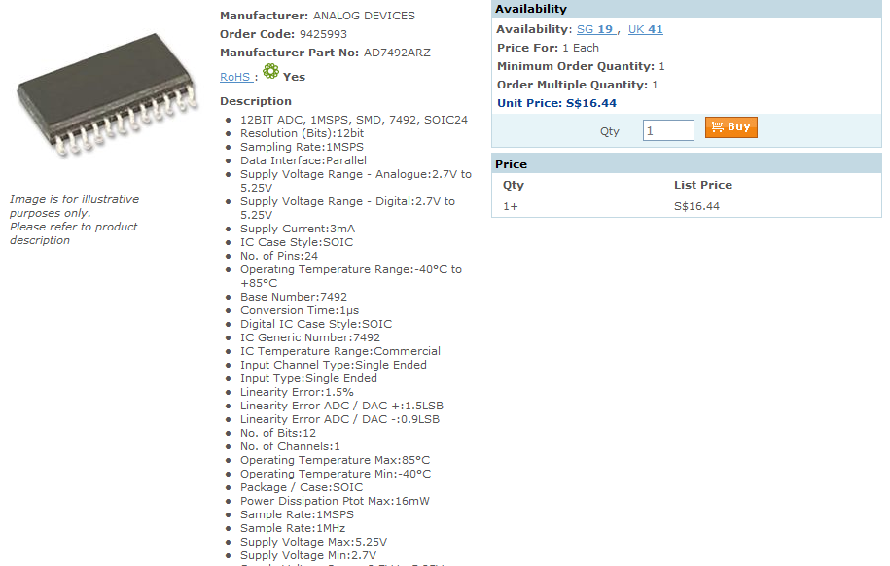
Notes:
This is a typical analog to digital converter of 12 bits that is sold by analog devices.

Slide 40
Quantization
Example:
Analog signal quantized by a 3-bit system
Notes:
Here you can see the circle is the actual analog amplitude signal value and the red cross is the approximate quantized value.
The step size is 0.5 or we call delta. Half the step size, 0.25 is the quantization error.
On the right of the diagram shows the binary codes and T is the sampling interval.

Slide 41
Quantization
Time | Original amplitude, x(nT) | Quantized amplitude, x(nT) | Binary code | Quantization error
0 | 0.000 | 0.00 | 000 | 0.000
T | 1.223 | 1.00 | 010 | -0.223
2T | 1.280 | 1.50 | 011 | 0.220
3T | 0.243 | 0.00 | 000 | -0.243
4T | -0.750 | -0.50 | 111 | 0.250
5T | -0.817 | -1.00 | 110 | -0.183
6T | -0.220 | 0.00 | 000 | 0.220
7T | 0.163 | 0.00 | 000 | -0.163
^
Notes:
This table clearly shoes the steps to compute the quantization error, quantized amplitude signal minus the original amplitude analog signal.
The binary codes are also shown

Slide 42
Common terminology
Maximum dynamic range of the quantizer is (1.5 - (-1.5))V = 3V. ( i.e. the range that quantizer can convert without problem).
Word-length of the quantizer, n, is 3 bits.
2’s complement encoding is used.
(Note that there is one more negative level than positive.)
Total number of quantization levels (or unique code words) is Q = 2^{m,} and 2^{m} -1 quantized segments
Notes:
Maximum dynamic range is calculated using both extreme values, 1.5 volts and -1.5 volts
Since it is a 3-bit quantizer, the word-length is 3.
2’s complement encoding is used

Slide 43

Quantization error
Quantization error :
Quantization noise?
In theory, quantization error is considered as a noise added to the unquantized signal:
How to reduce quantization error?
increase quantizer word length.
depends on the CPU and ADC used.
Notes:
To reduce this quantization error, we can use a quantizer with a larger word length (larger m). However, the choice of m (or the number of bits to encode the signal) is actually an application issue. It depends on the number of bits (word size) of the processor and quantizer used.

Slide 44
Quantization error
In studying DSP theory, we assume that the word length infinite that is no quantization error.
For the rest of the course, we will be using un-quantized signals in our analysis; even though we have to quantize the signal in practice.
Notes:
In studying DSP theory, it is usually assumed that the digital data have infinite word length, that is no quantization error. During implementation, the quantization error (due to finite word length) is considered as a quantization noise added to the unquantized signal. For the rest of the chapters we will be using unquantized signals in our analysis instead of binary codewords; even though we would have to quantize the signal in actual implementation.

Slide 45




Key Points
Digitization: Sampling & Quantization
Digital Signal Processing
Digital to Analog Conversion
Notes:
Key points
The analog signal by going through a transducer is converted to an electrical signal, continuous amplitude and continuous time signals.
It undergone sampling to change it to continuous amplitude and discrete time signal which we term as discrete time signals
It is further process using quantizer to discrete time discrete amplitude signals

Slide 46
Important points to note
- Real signals are analog and continuous
- Fourier Transform allows us to see signals from a different perspective. Therefore we use Fourier Transform to analyse signals.
- First step of digitizing is to sample the signal with the right frequency
- After sampling we observe that original frequency spectrum of the signal repeated around sampling frequency and its multiples.
- To properly sample the signal we need to use a sampling frequency, fs, which is at least the twice of the maximum frequency, fm, component of the signal.
Notes:
Real signals are analog and continuous
We use fourier transform to convert the time domain into frequency domain
Sampling allows the conversion of continuous time to discrete time
Quantization after sampling converts the continuous amplitude to discrete amplitude
The selection of the correct sampling frequency according to nyquist theorem is important to avoid aliasing problem

Slide 47
Summary
Problems can arise when a continuous-time signal is converted to a discrete-time signal.
To ensure not loss of information during conversion, sampling theorem must be satisfied.
That is, the sampling frequency must be at least twice the highest frequency component of the continuous-time signal.
Quantization error or noise can be reduced by higher word length.
Notes:
The sampling frequency must be at least twice the highest frequency component of the continuous-time signal.
To avoid aliasing, the continuous time signal can be bandlimited by using a low pass filter but certain higher frequencies of the signal will be lost or by using a very high sampling frequency to minimize aliasing.
Quantization noise can be reduced by having higher word length.

